Slide 1
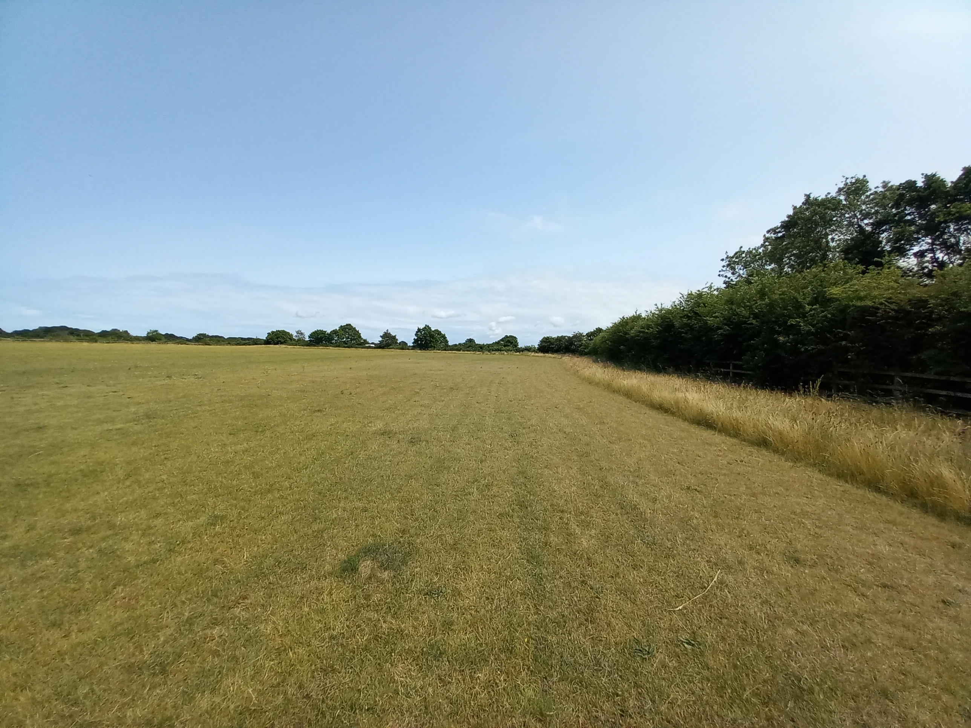
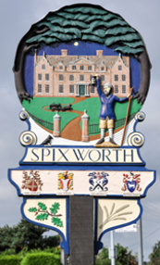
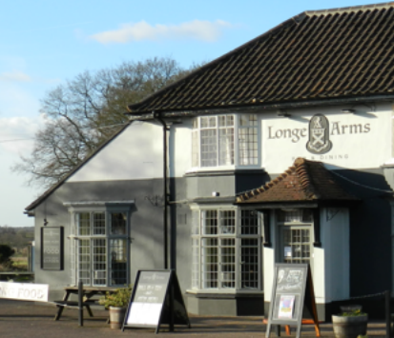
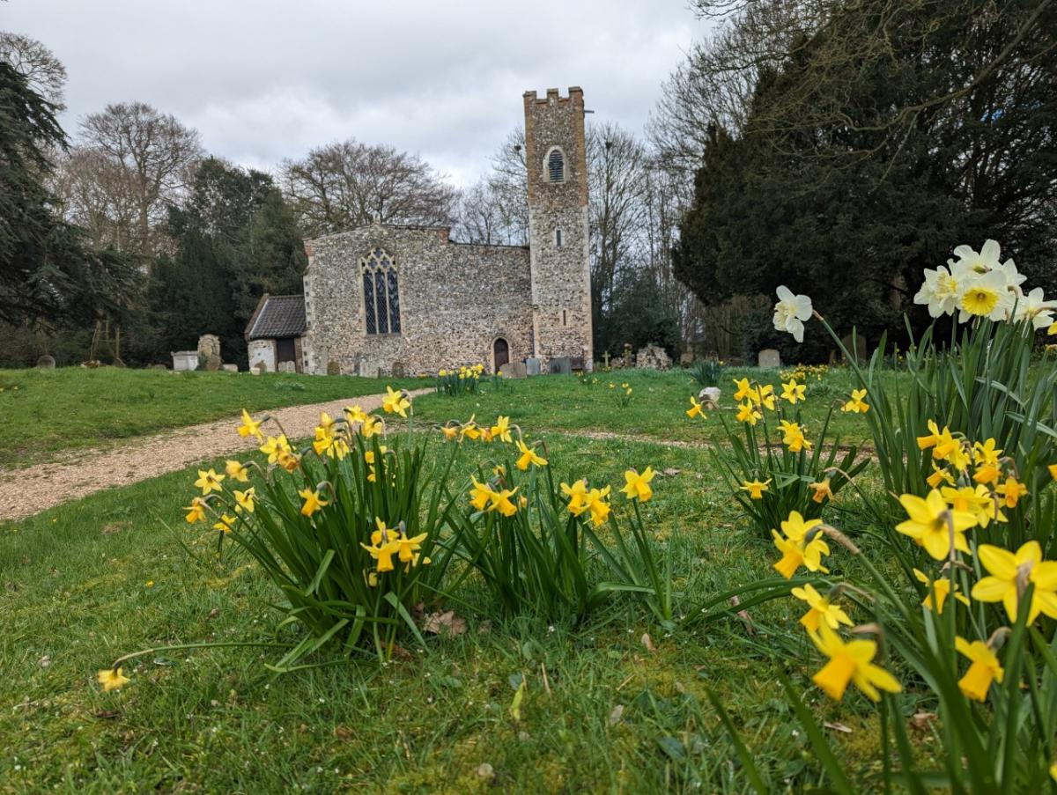
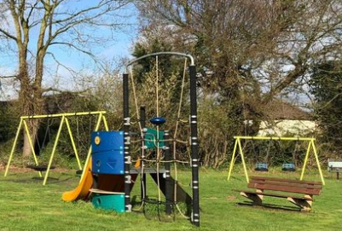
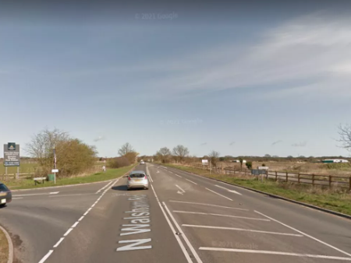
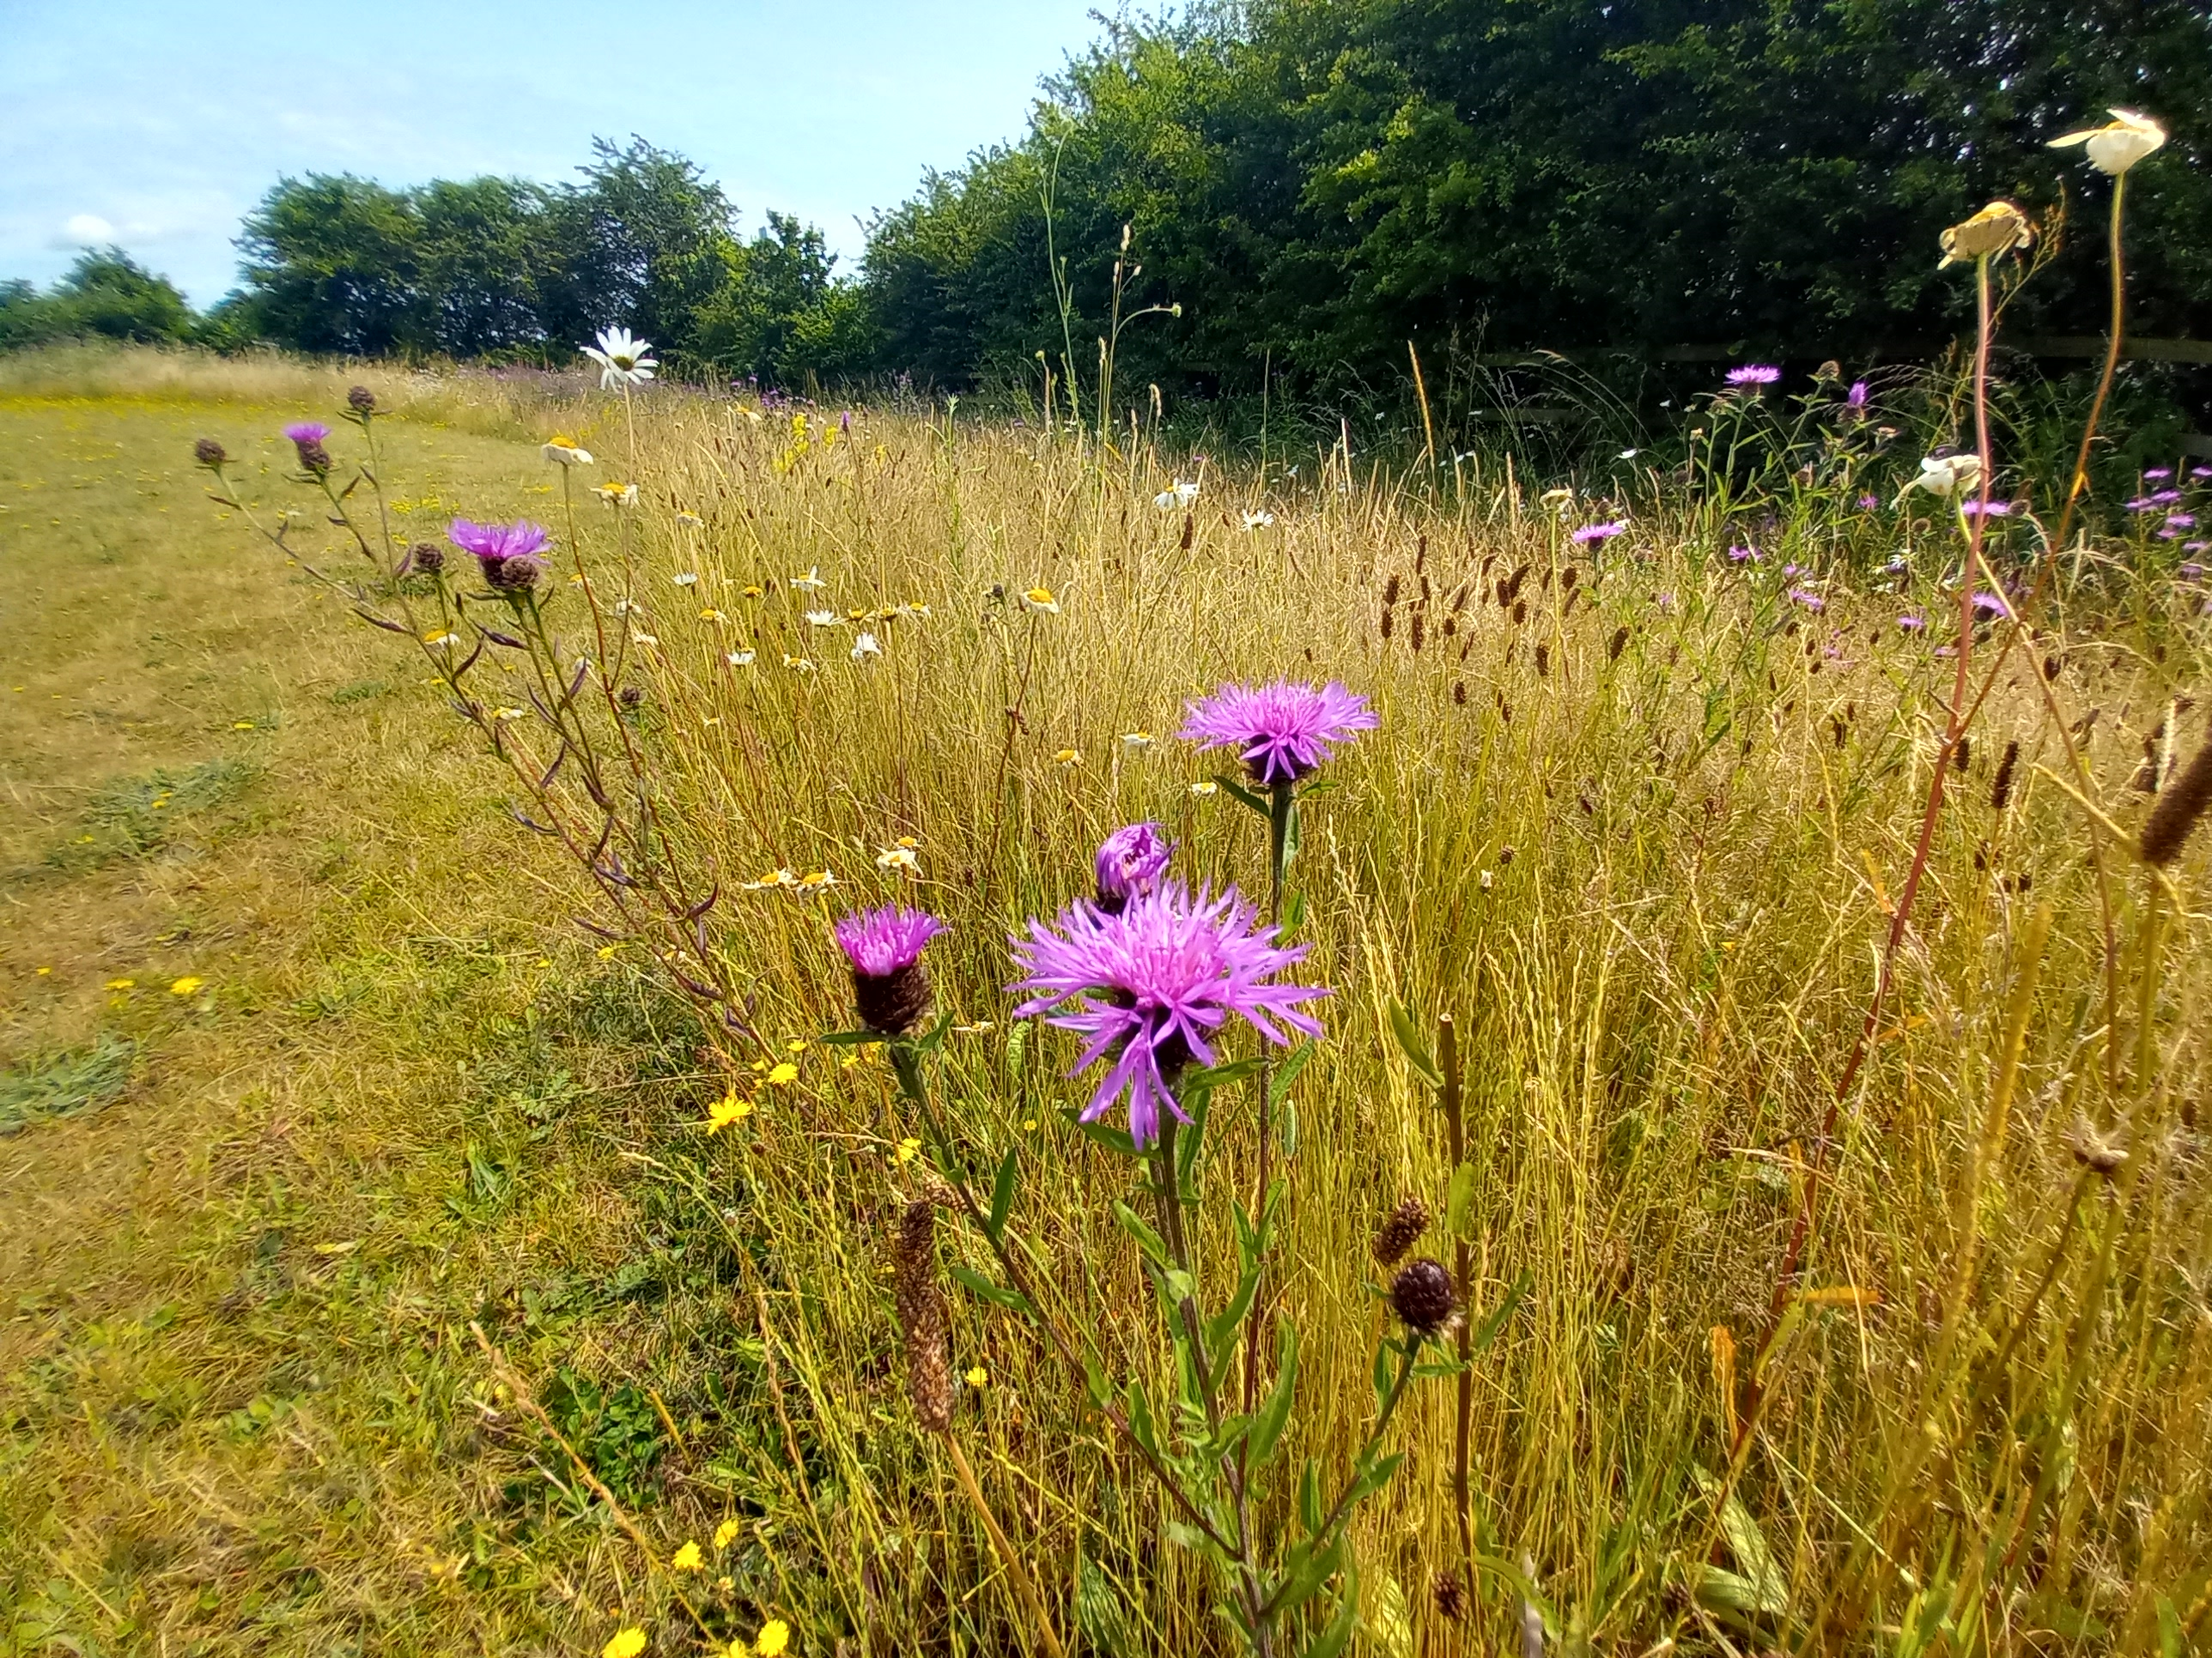
Spixworth Parish Council | Strategic Plan 2023 – 2027
July 2023

Slide 2
Spixworth Parish Council | Strategic Plan 2023 – 2027
Contents July 2023
Section | Contents | Page
1 | Summary | 2
2 | Strategy Structure | 3
3 | Strategic Initiative Alignment | 4
4 | Strategic Initiative Descriptions and Outcomes | 5
5 | Strategic Initiative Prioritisation | 6
6 | High Level Roadmap | 7
7 | Appendices | 8, 9
1

Slide 3
Spixworth Parish Council | Strategic Plan
1. Summary
Background
Following the recent local elections in May, Spixworth Parish Council has a refreshed mandate over the next four-year term to serve and represent the local community of Spixworth
With this new four-year term (May 2023 - May 2027), the Chairman has implemented a working group consisting of a small number of Parish Councillors and Parish Clerk, supported by the wider council, to design a strategic plan for implementation during the new term
The working group intends to share the initial draft of this plan when the council reconvenes in September 2023, following the summer break
Approach
The Parish Council already has a solid basis on which to build the strategic plan, utilising the Spixworth Neighbourhood Plan (SNP). As such, the SNP is used as a ‘steel thread’ around which a mission statement has been built to complement the existing vision statement and key themes. There is also the addition of one new key theme – ‘Governance’, which addresses the need to ensure operating effectiveness, efficiency and sustainability of the Parish Council
With the vision, mission statement and key themes in place, the working group has then consolidated and rationalised the SNP key objectives with the intent to provide a more streamlined and simple set of objectives that form the critically important goals that must be achieved over the plan period to deliver the vision
A proposed set of strategic initiatives have then been identified, with alignment to the key themes and objectives. These initiatives are resultant from deliberation of the working group, existing initiatives well known to the wider Parish Council and those prominently raised by the local community, such as the North Walsham road junction solution. It should be noted that the main concentration of initiatives as this stage are within the ‘Governance’ and ‘Community & Facilities’ themes, with some initiatives such as the Crostwick Lane Amenity Land project, crossing into other themes
A simple approach has then been taken to prioritise these based on strategic importance and urgency, before then drawing out a high-level roadmap for delivery
It is important to note that the roadmap is directional only and will be subject to refinement as the Parish Council moves through it’s delivery, including the addition of new initiatives and re-prioritisation of those initially identified here
Immediate Next Steps
Share this paper for reading ahead of the September Parish Council meeting - Aug
Discuss and agree the proposed set of Initiatives and priority order at the September Parish Council meeting – 5th Sept
Refresh the plan with any changes agreed and re-share – Sept
Build out detailed plan & success measures for tracking delivery – Sept
2

Slide 4
Spixworth Parish Council | Strategic Plan
2. Strategy Structure
“To allow Spixworth to evolve & grow in a way that retains its rural setting & village character.
Improving the quality of life & local facilities for all generations by respecting & reflecting the needs of the local community”
SNP Vision
An inspirational and aspirational vision for the future state of the village
Mission Statement
Who the Parish Council is, who it serves, what it’s objectives are and how it will achieve those objectives
To develop a democratic and representative voice for the community; where our services are provided and managed to a good quality standard in an effective and responsible way, at an affordable cost
Strategic Themes
Key areas SPC must deliver improvements in to achieve our vision and fulfil our mission
Infrastructure & Transport
Environment & Landscape
Community & Facilities
Design & Housing
Local Economy
Governance
Strategic Objectives
Critically important goals the council must achieve over the plan period
(See page 3)
Strategic Initiatives
The things the council must deliver to achieve the strategic goals
(See page 4)
3

Slide 5
Spixworth Parish Council | Strategic Plan
3. Strategic Initiative Alignment
Strategic Theme | Strategic Objectives | Strategic Initiatives
Governance | To conduct Council business in a professional manner, demonstrating best practice, good governance and financial accountability | Governance Structure Review Finance Reporting Review Policy & Legal Review Projects Prioritisation Process Media Policy Staffing Review Councillor Training Programme
Infrastructure & Transport | To reduce the negative impact of traffic (volume, speed, safety & parking) on our roads & improve road safety, whilst striving for the delivery of sustainable transport modes that help us reduce our carbon emissions in Spixworth & the surrounding area | North Walsham Road Junction Neighbourhood Plan Review*****
Environment & Landscape | To work towards a cleaner, greener and safer Spixworth, protecting open spaces, enhancing biodiversity, wildlife and surrounding countryside | Allotments** Crostwick Lane Amenity Land Project** Neighbourhood Plan Review
Community & Facilities | To develop and enhance the Council’s facilities and amenities for residents of all ages, encouraging involvement of the community in the Parish Council through active Engagement, effective & innovate communication methods , to help establish its aspirations for the future To promote and engage in partnership working with principal authorities, voluntary and youth organisations for the improvement of Council services | Village Hall Play & MUGA upgrade Allotments Parish Councillor Recruitment Plan/Pipeline Development Resident Engagement Survey Events and Communication Plan Public Image Improvement Plan (web/social media) Crostwick Lane Amenity Land Project Cedar Avenue Play Park Upgrade Neighbourhood Plan Review
Design & Housing | To continue to preserve and enhance the character of Spixworth and to support appropriate development: using the National Planning Policy Framework to safeguard its unique identity and environment | Neighbourhood Plan Review
Local Economy | To encourage & support new & existing business to improve local employment opportunities within the parish & seek to strengthen the local economy & village shops | Neighbourhood Plan Review
* asterix denotes number of times initiative occurs across multiple themes/objectives
4

Slide 6
Spixworth Parish Council | Strategic Plan
4. Initiative Descriptions
Strategic Initiative | Description | Outcome
1. Governance Structure Review | Review of structure and execution of parish council governance against best practice, with areas for improvement identified and actions agreed to address | Strong internal governance ensuring operating effectiveness and sustainability of the parish council
2. Finance Reporting Review | Review of financial processes and reporting and improvement actions identified and implemented | Effective process, oversight, reporting and management of the parish council finances
3. Policy & Legal Review | Review of policy and legal framework and improvement actions identified and implemented | Operating effectiveness within policy and legal framework
4. Projects Prioritisation Process | Design and implementation of a framework for identifying, prioritising and delivering projects | Effective and consistent prioritisation of projects in accordance with the strategy and key objectives
5. Media Policy | Design and implementation of a policy outlining the conduct of the Parish Council with regards to media including online social media and local and national press | Consistent and appropriate media engagement
6. Staffing Review | Review of staffing structure, contracts, roles and responsibilities etc | Clear roles and responsibilities, right levels of staff appropriately rewarded and delivering expected outputs
7. Councillor Training Programme | Design and implementation of Councillor training programme | Knowledgeable and capable councillors, providing council and supporting delivery of the council’s strategy
8. North Walsham Road Junction | Road Traffic and pedestrian Solution implemented | Improved safety for residents of Spixworth, traffic and pedestrian, using the junction
9. Village Hall & MUGA upgrade | Completion of build and opening of the Village Hall & MUGA court upgrade | Improved recreational play and sports facilities and equipment
10. Allotments | Completion of build and opening of the village allotments | Provision of allotments for residents
11. Parish Councillor Recruitment Plan | Design and implementation of a recruitment and pipeline plan | Effective recruitment ensuring the council is always right sized with the skills required to support delivery of the council’s strategy
12. Resident Engagement Survey | Design and implementation of engagement survey | Understanding of how residents feel about the council, the village and opportunities to improve
13. Events & Communication Plan | Design and implementation of an events and communications plan | Highly engaged community
14. Public Image Improvement Plan | Review of Parish Council public image including website and social media | Improved visibility and design of parish council web & social media
15. Crostwick Lane Amenity Land Project | Delivery of Crostwick Lane Amenity land project | Unique amenity land space for residents to enjoy
16. Cedar Avenue Play Park Upgrade | Delivery of Cedar Avenue play park upgrade | Improved recreational play facilities and equipment
17. Neighbourhood Plan Review | Review of Neighbourhood plan | Relevant neighbourhood plan for ongoing use
5

Slide 7
Spixworth Parish Council | Strategic Plan
5. Strategic Initiative Prioritisation
Priority Map
HIGH
Ref | Force Ranked by Estimated Delivery Completion Date
9 | Village Hall Play & MUGA upgrade – HIGH (Sept ‘23)
7 | Councillor Training Programme – HIGH (Sept/Oct ’23)
10 | Allotments Open – HIGH (Oct ‘23)
6 | Staffing Review – HIGH (Oct ‘23)
2 | Finance Reporting Review – HIGH (Oct ‘23)
1 | Governance Structure Review – HIGH (Oct ‘23)
3 | Policy & Legal Review – HIGH (Dec ‘23)
4 | Projects Prioritisation Process - MEDIUM (Jan ‘24)
13 | Events and Communication Plan – MEDIUM (Q1 ‘24)
5 | Media Policy – MEDIUM (Q2 ‘24
11 | Parish Councillor Recruitment Plan – MEDIUM (Q2 ‘24)
12 | Residents Engagement Survey – MEDIUM (Q2 ‘24)
8 | North Walsham Road Junction – HIGH (Q4 ’24)
14 | Public Image Improvement Plan (web/social media) – MEDIUM (Q1 ‘25)
17 | Neighbourhood Plan Review – MEDIUM (Q1 ‘25)
15 | Crostwick Lane Amenity Land Project – HIGH (Q2 ‘25)
16 | Cedar Avenue Play Park Upgrade – MEDIUM (Q1 ‘26)
3
2
1
6
8
17
7
15
9
10
11
4
13
MEDIUM
5
Strategic Importance
16
12
14
LOW
LOW
MEDIUM
HIGH
Urgency
H | Must Do - Critical to achieving the strategic objective high in urgency
M | Should Do – Important to achieving the strategic objective but not urgent
L | Could Do – Not important to achieving the strategic objective and no level or urgency
6

Slide 8
Spixworth Parish Council | Strategic Plan
6. High Level Roadmap
2023
2024
2025
2026
Q3
Q4
Q1
Q2
Q3
Q4
Q1
Q2
Q3
Q4
Q1
Q2
Q3
Q4
Governance
Parish Councillor Training Programme
2027
Governance Structure Review
Finance Reporting review
Policy & Legal Review
Staffing Review
Projects Prioritisation Process
Media Policy
Parish Councillor Recruitment/Pipeline plan
Infrastructure & Transport
North Walsham Road Junction solution completed
Environment & Landscape
.
Environment & Landscape
.
Community & Facilities
Village Hall Play/MUGA upgrade complete
Community & Facilities
Allotments Open
Events & Communications Plan
Resident Engagement Survey
Crostwick Lane Amenity Land completed
Public Image Improvement Plan (Web/Social Media)
Design & Housing
Design & Housing
Neighbourhood Plan Review
Cedar Avenue Park upgrade
Local Economy
Local
Economy
.
7

Slide 9
Appendices

Slide 10
Spixworth Parish Council | Strategic Plan
7.1 Rationalisation of SNP Strategic Objectives
Infrastructure & Transport
To reduce the negative impact of traffic (volume, speed, safety & parking) on all our roads. To support more sustainable transport by improving pedestrian & cycle links to wider countryside & enhanced public transport
To reduce the negative impact of traffic (volume, speed, safety & parking) on our roads & improve road safety, whilst striving for the delivery of sustainable transport modes that help us reduce our carbon emissions in Spixworth & the surrounding area
Seek solutions & the timely provision of improvements to Spixworths infrastructure. Practical steps to improve road safety & reduce the negative impacts of traffic. Challenge those seeking to increase traffic levels or flood risk, through new development, to understand the wider impacts on the local community. Strive for the delivery of sustainable transport modes
Environmental & Landscape
To protect the countryside & farmland surrounding our village, promoting green space, woodland and enhancing nature conservation with improved access to the countryside
To work towards a cleaner, greener and safer Spixworth, protecting open spaces, enhancing biodiversity, wildlife and surrounding countryside
Act to ensure the beauty, natural open spaces, wildlife, built & natural form in & around Spixworth are protected whilst seeking to enhance biodiversity & the surrounding countryside
Community & Facilities
To develop and enhance the Council’s facilities and amenities for residents of all ages, encouraging involvement of the community in the Parish Council through active Engagement, through effective & innovate communication methods , to help establish its aspirations for the future
To develop & improve local community facilities & services (such as community centre/village hall, other recreation, education & medical facilities) for all age groups
Work with key stakeholders to guide delivery, service improvements & new facilities to meet the future needs & desires of local residents
To promote and engage in partnership working with principal authorities, voluntary and youth organisations for the improvement of Council services
Design & Housing
To support housing growth tailored to the needs of Spixworth, where development is sensitive, protecting & enriching the landscape & in keeping with the built setting
To preserve the character of Spixworth, including the spatial balance between the rural & built environment, historical assets, character, & feel as well as improving the design of homes & development
To continue to preserve and enhance the character of Spixworth and to support appropriate development: using the National Planning Policy Framework to safeguard its unique identity and environment
Proactively work with developers & Broadland District Council to influence incremental growth that is aligned to the local community’s needs. Seeking high standards of development to provide better homes for people to live in
Local Economy
To encourage & support local businesses, shops & local employment within the parish
Encourage new & existing business to improve local employment opportunities & seek to strengthen the local economy & village shops
To encourage & support new & existing business to improve local employment opportunities within the parish & seek to strengthen the local economy & village shops
Funding to support the delivery of the SNP will be sought from Broadland District Council, through a combination of money from s106 planning obs/s728 agreements & from other sources as maybe available
Governance
To conduct Council business in a professional manner, demonstrating best practice, good governance and financial accountability
9

Slide 11
“To allow Spixworth to evolve & grow in a way that retains its rural setting & village character.
Improving the quality of life & local facilities for all generations by respecting & reflecting the needs of the local community”
SNP Vision
An inspirational and aspirational vision for the future state of the village
Mission Statement
Who the Parish Council is, who it serves, what it’s objectives are and how it will achieve those objectives
2023
2027
To develop a democratic and representative voice for the community; where our services are provided and managed to a good quality standard in an effective and responsible way, at an affordable cost
Strategic Themes
Key areas SPC must deliver improvements in to achieve our vision and fulfil our mission
Governance
Infrastructure & Transport
Environment & Landscape
Community & Facilities
Local Economy
Design & Housing
To develop and enhance the Council’s facilities and amenities for residents of all ages, encouraging involvement of the community in the Parish Council through active Engagement, effective & innovate communication methods , to help establish its aspirations for the future
To promote and engage in partnership working with principal authorities, voluntary and youth organisations for the improvement of Council services
To reduce the negative impact of traffic (volume, speed, safety & parking) on our roads & improve road safety, whilst striving for the delivery of sustainable transport modes that help us reduce our carbon emissions in Spixworth & the surrounding area
To encourage & support new & existing business to improve local employment opportunities within the parish & seek to strengthen the local economy & village shops
To continue to preserve and enhance the character of Spixworth and to support appropriate development: using the National Planning Policy Framework to safeguard its unique identity and environment
To conduct Council business in a professional manner, demonstrating best practice, good governance and financial accountability
To work towards a cleaner, greener and safer Spixworth, protecting open spaces, enhancing biodiversity, wildlife and surrounding countryside
Strategic Objectives
Critically important goals the council must
achieve over the plan period
Governance Structure Review
Finance Reporting Review
Policy & Legal Review
Projects Prioritisation Process
Media Policy
Staffing Review
Councillor Training Programme
North Walsham Rd Junction
Crostwick Lane Amenity Land
Village Hall Play & MUGA upgrade
Allotments
Neighbourhood Plan Review
Strategic Initiatives
The things the council must deliver to achieve the strategic goals
Events and Communication Plan
Resident Engagement Survey
Cedar Avenue Play Park Upgrade
Web/Social Media

